Slide 1
Econometrics of Firm Data
Introduction to exercises
Mette Suder Franck, msf.eco@cbs.dk
DVIP, Department of Economics

Slide 2
Agenda
General introduction to exercise classes
Econometric mindset and way of thinking
Recap of key concepts from Ralfs’ lectures that will be useful today
Interpretation of coefficient estimates
Inference and hypothesis testing
Goodness-of-fit
Exercises!

Slide 3
General introduction
Teaching format & practicalities
We have three exercise classes with more exercises to cover than time allows, therefore…
Work with exercises ahead of class, so you get an impression of which exercises you would like me to prioritize covering during class
You are encouraged to present solutions alone or in groups during class as a learning exercise
If no requests for specific exercises, I will choose what to cover
Solutions for all exercises will be available after class including code for both STATA and R
In class, I will focus on intuition and switch between showing code in R and STATA
For questions related to exercise classes reach out to me: msf.eco@cbs.dk
For questions related to exam or lectures: Utilize Ralf’s office hours

Slide 4
Econometrics
Machine learning
Used to understand relationships
Emphasis on:
Hypothesis testing & model validation
Interpretation & significance of coefficients
Use case: Understand why customers default to inform policy-making
Used to predict behaviour/outcomes
Emphasis on:
Predictive performance, accuracy & generalization
Hyperparameter tuning
Use case: Predict which customers will default to allow for proactive outreach
Note: Illustrative and non-exhaustive
Notes:
Many similarities, but important to be aware of the different mindsets

Slide 5
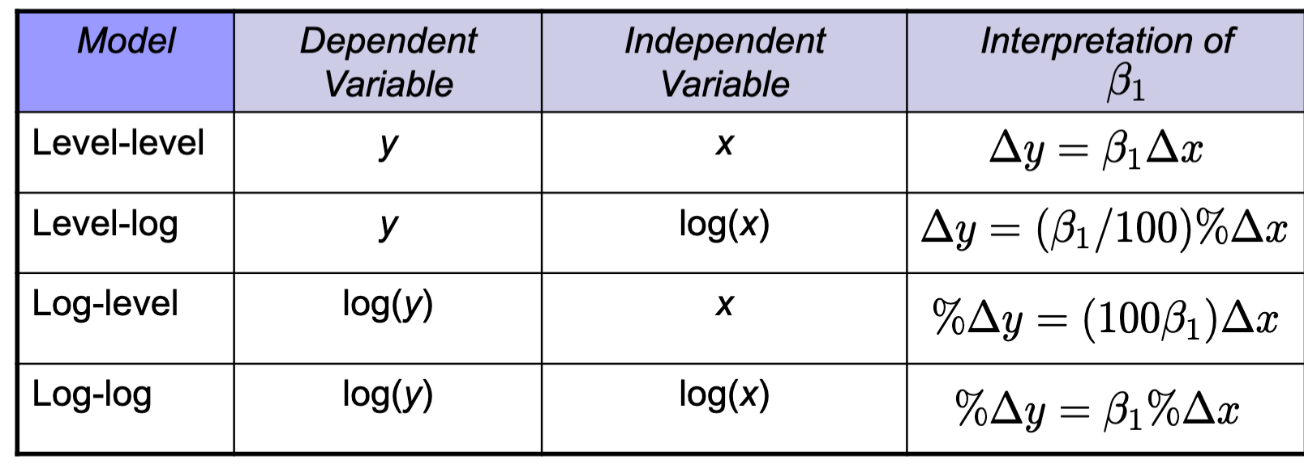
Interpretation of coefficient estimates
Units of measurement and transformation matters for interpretation
Source: Ralf’s slide

Slide 6
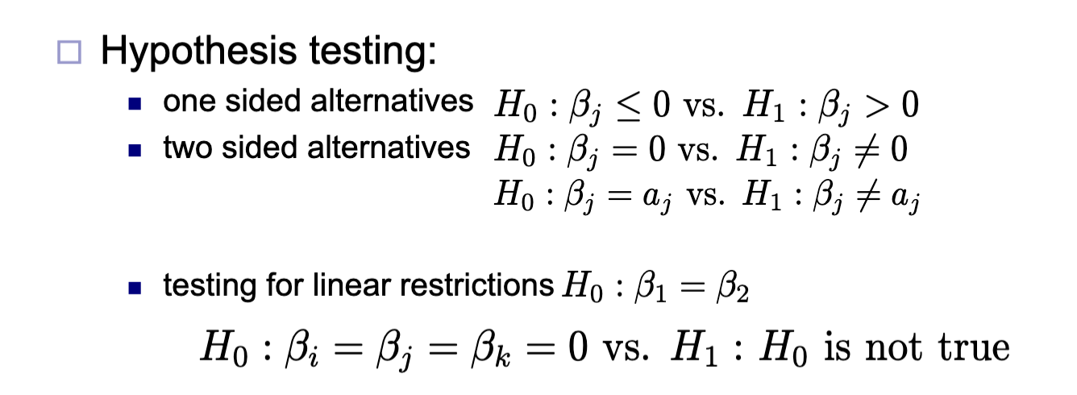
Inference and hypothesis testing
What does our coefficient estimates indicate about statistical significance of the covariates?
Here focus of statistical significance, but in most applications we are also interested in practical or economic significance of estimates: Is the estimated coefficient size small or large? What does it imply for real-life significance?
Source: Ralf’s slide OLS_estimation_inference.
Note: There are many other types of hypotheses to test for a specific regression model. What tests are relevant depends on your research question at hand. There is a lot of useful information in Ralf’s slides! Slide 60 in particular has some good practical advice on how to interpret coefficients.

Slide 7
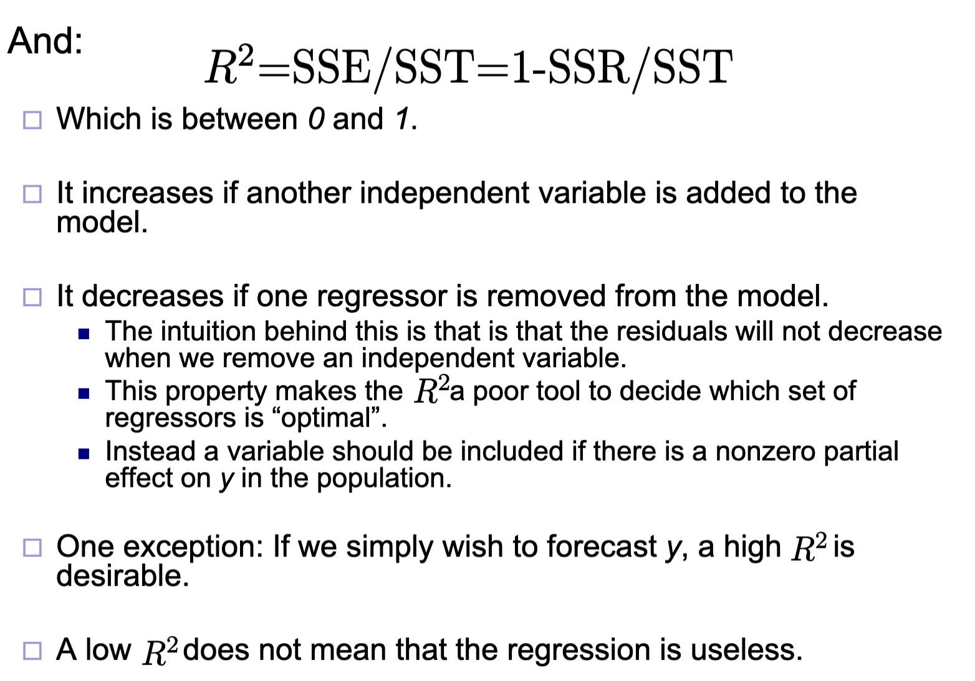
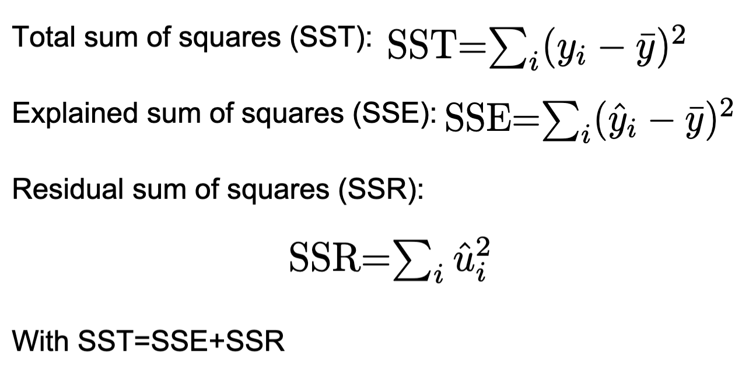
Goodness-of-fit
R² and how to use it
Source: Ralf’s slide OLS_estimation_inference
Notes:
Interpretation of R-squared? What does higher/lower value indicate?

Slide 8
Time for exercises!
Any requests for specific exercises?

Slide 9
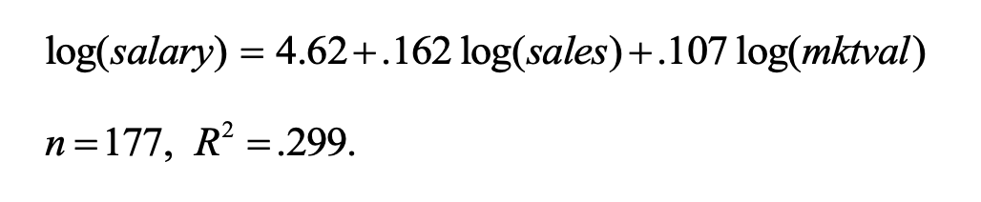

PS 1 – Part 2, Exercise 3 a)

Slide 10
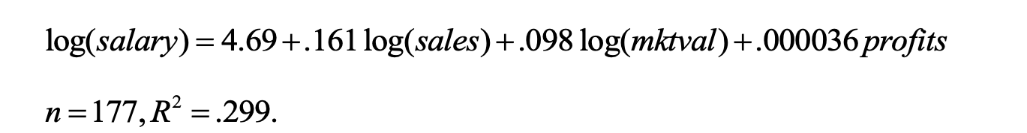
PS 1 – Part 2, Exercise 3 b)

Slide 11
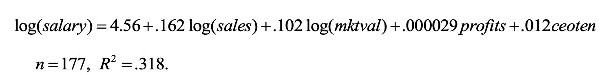
PS 1 – Part 2, Exercise 3 c)

Slide 12
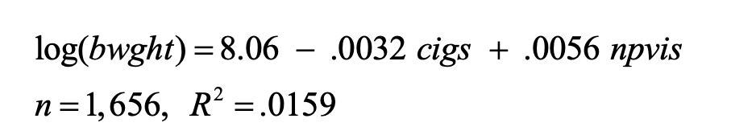
PS 1 – Part 2, Exercise 4 a)

Slide 13
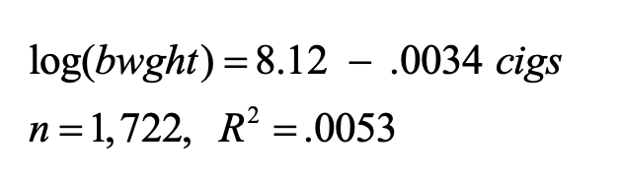
PS 1 – Part 2, Exercise 4 c)
A)
C)

Slide 14
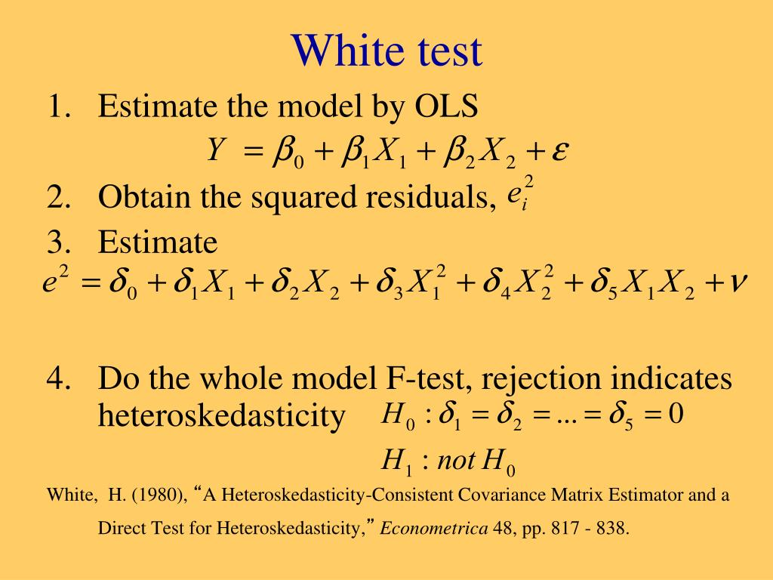
Problem set 2, 2b)
General idea behind White test for heteroskedasticity
In other words the null hypothesis is that errors are homoskedastic

Slide 15
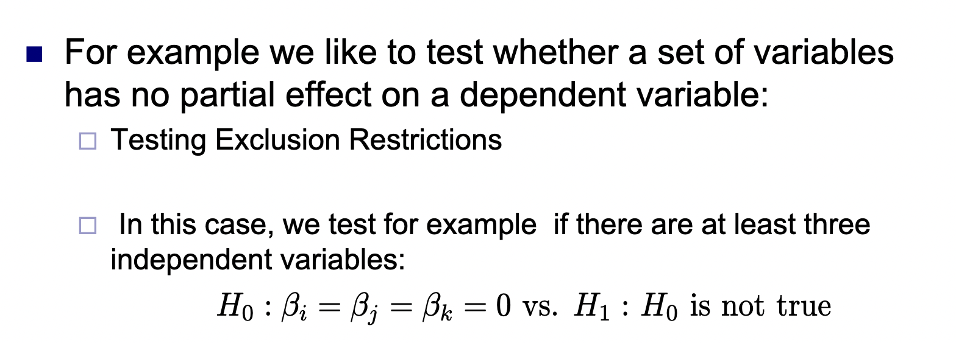
Problem set 2, 3b)
Testing Multiple Linear Restrictions
Source: Ralf’s slide OLS_estimation_inference

Slide 16
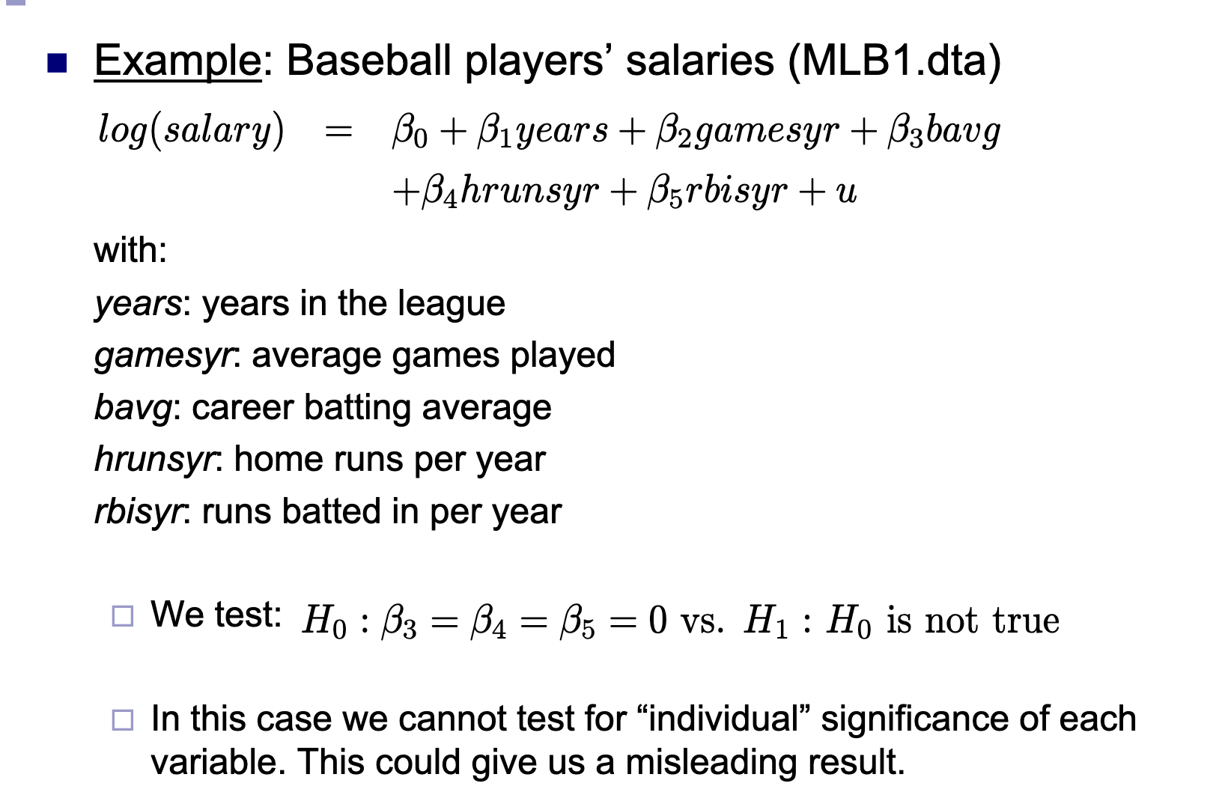
Problem set 2, 3b)
Testing Multiple Linear Restrictions
Source: Ralf’s slide OLS_estimation_inference

Slide 17
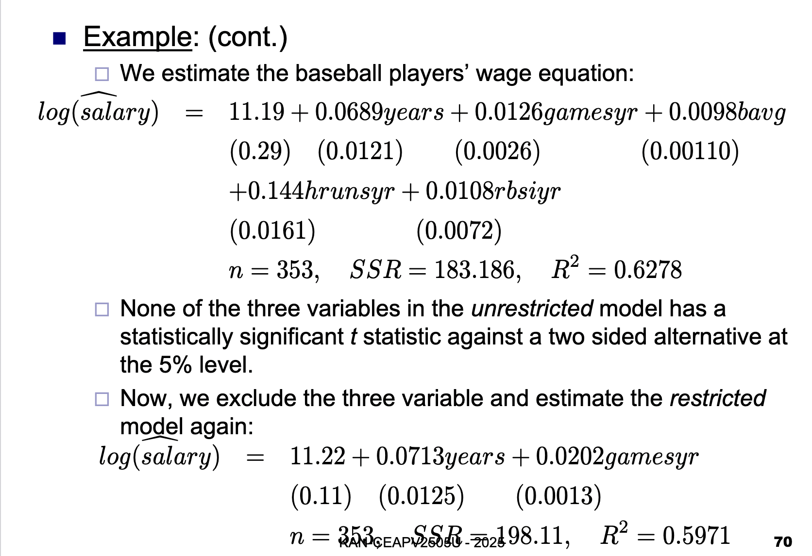
Problem set 2, 3b)
Testing Multiple Linear Restrictions
Source: Ralf’s slide OLS_estimation_inference

Slide 18
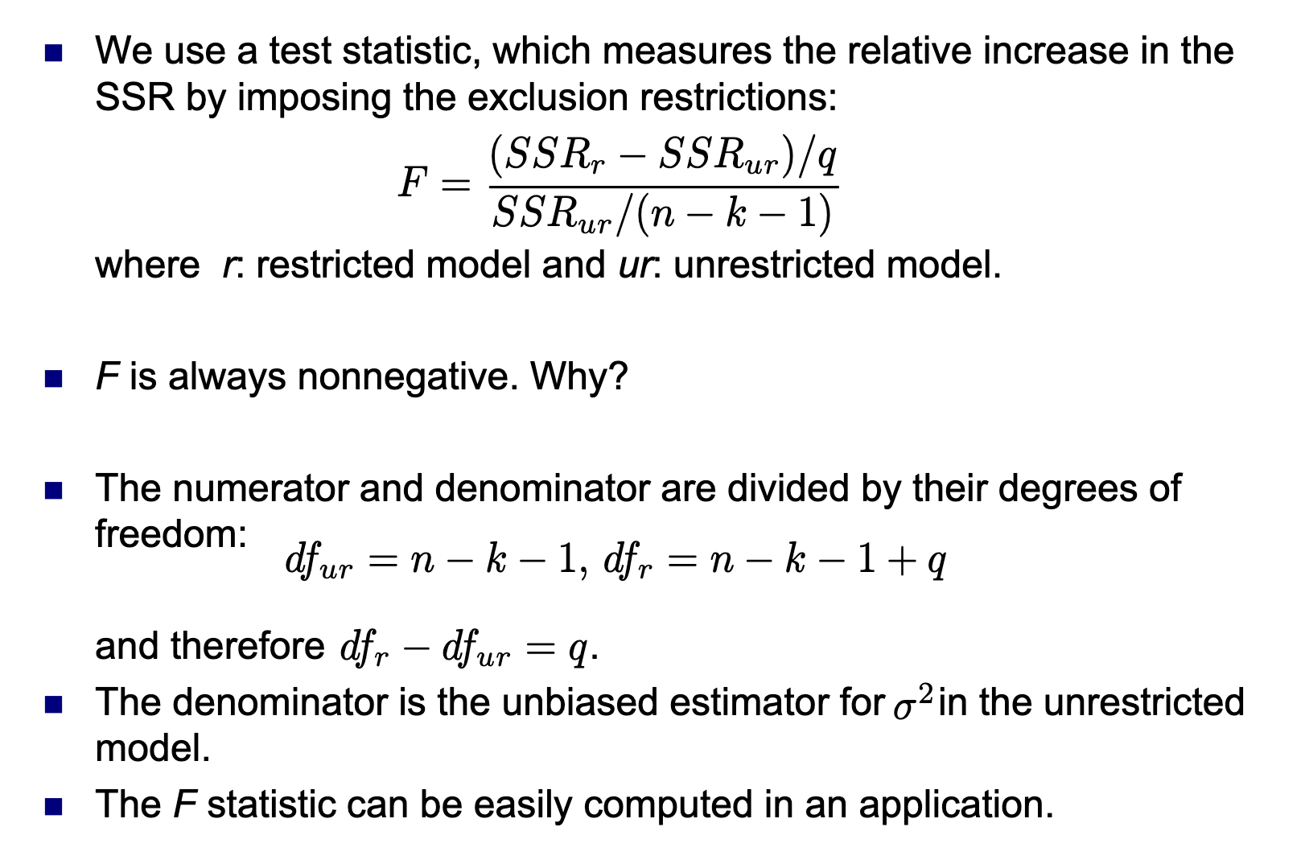
Problem set 2, 3b)
Testing Multiple Linear Restrictions
Source: Ralf’s slide OLS_estimation_inference

Slide 19
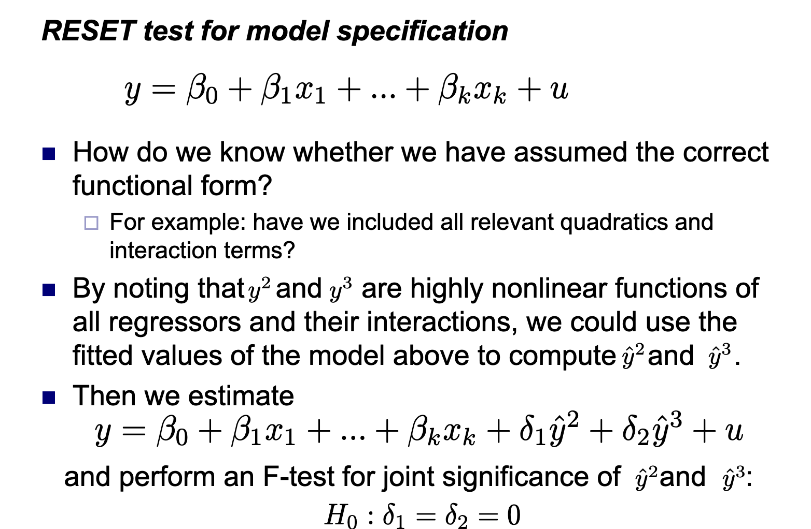
Problem set 2, 3c)
Source: Ralf’s slide OLS_estimation_inference

